Slide 1

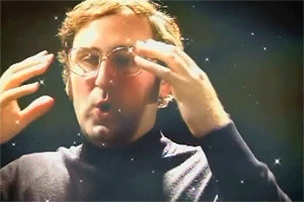
Milestone 1
Azeezat, Han, Mansi, Shafiq
February 6, 2019

Slide 2
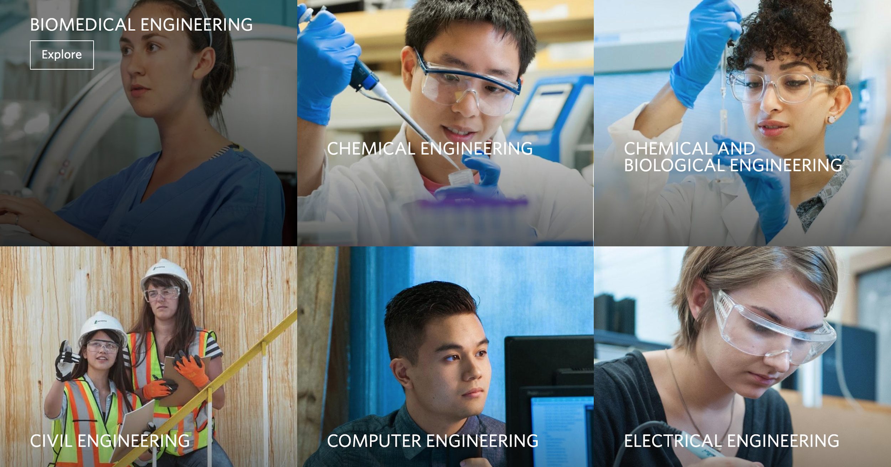
Nice and inviting; colorful without being too harsh
Information was straightforward and useful
Discoverable
Notes:
Azeezat

Slide 3
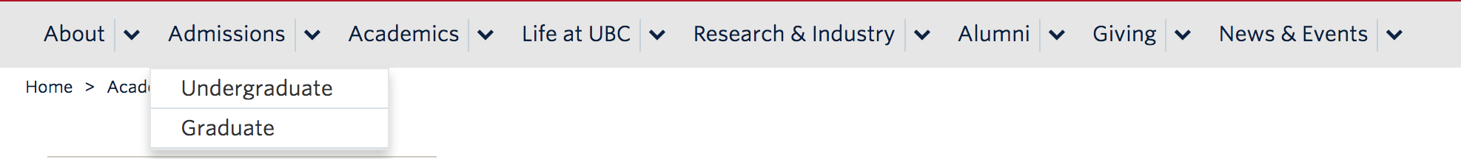
Drop down menu was clear - separated between graduate and undergraduate students

Slide 4
There wasn’t much that was disliked about this website, and if possible;
We would like to incorporate as much of what was on this website as we can into our University of Regina website.

Slide 5
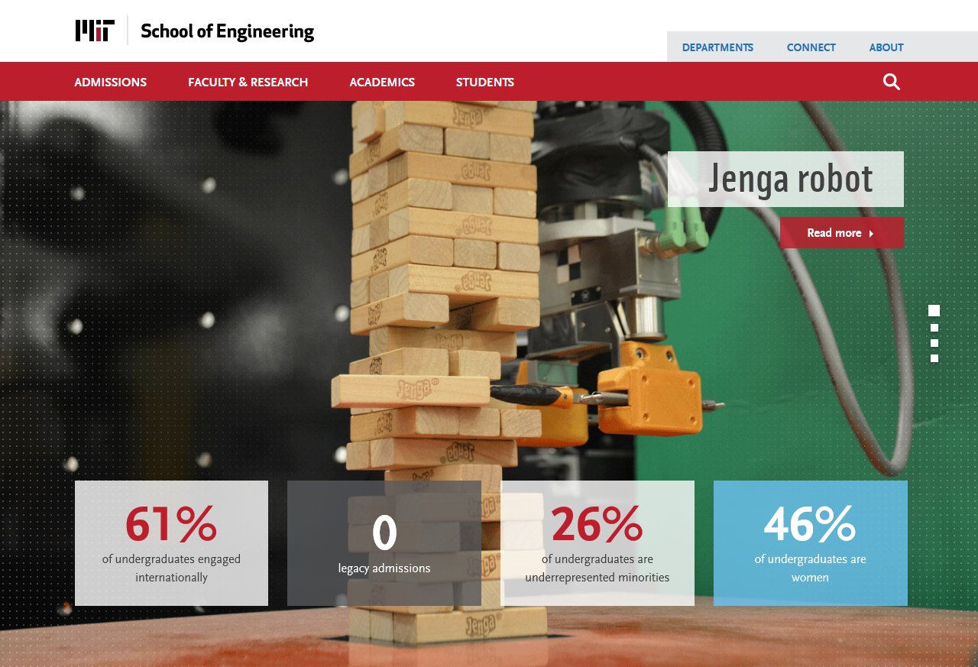
Up-to-date
Organized and Straightforward
Good Content Strategy
Innovative
Notes:
Shafiq

Slide 6
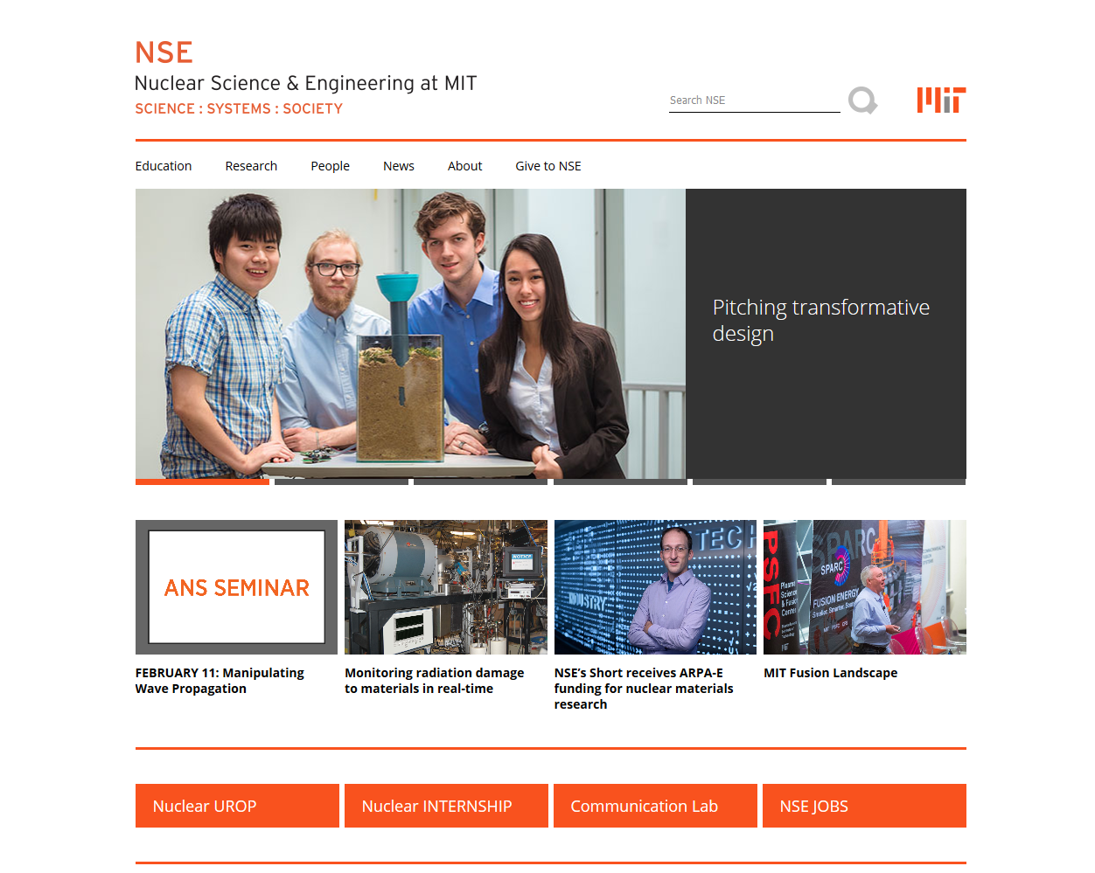
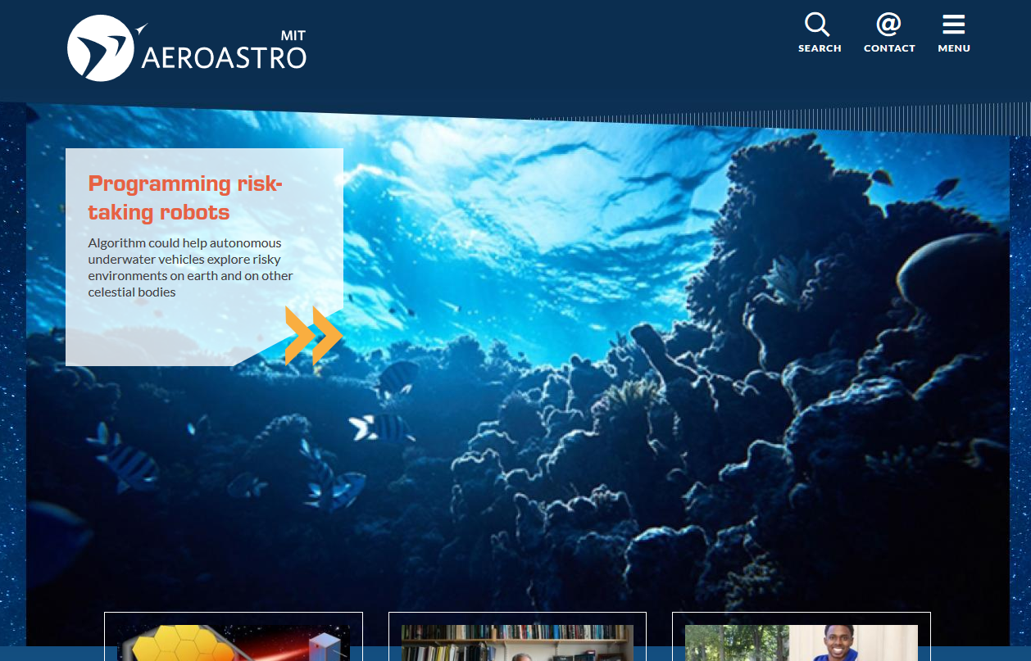
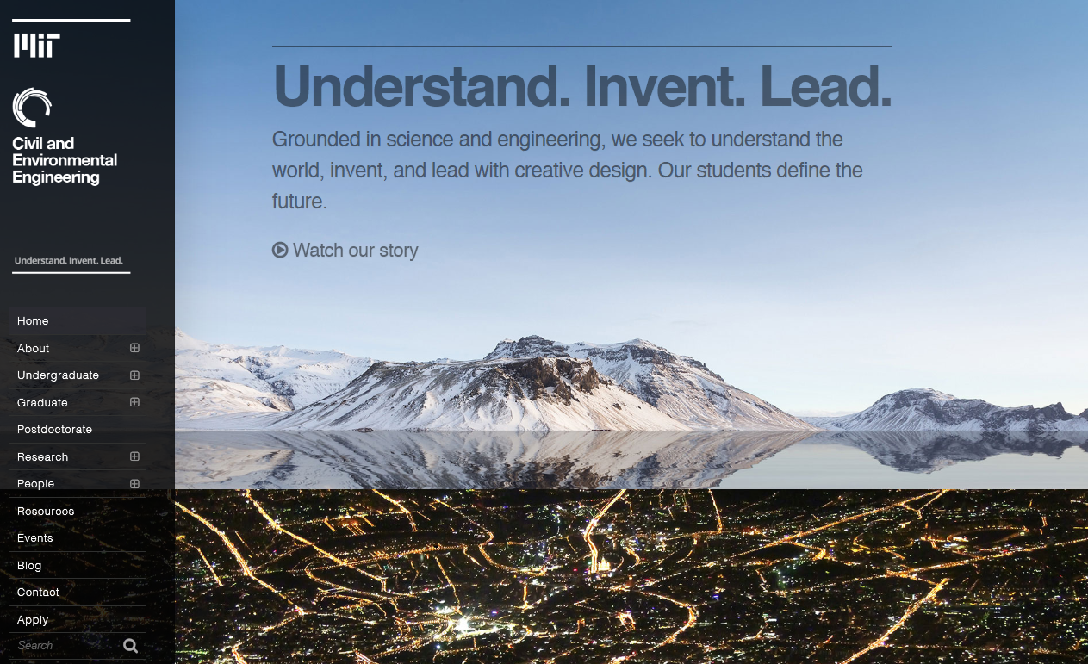
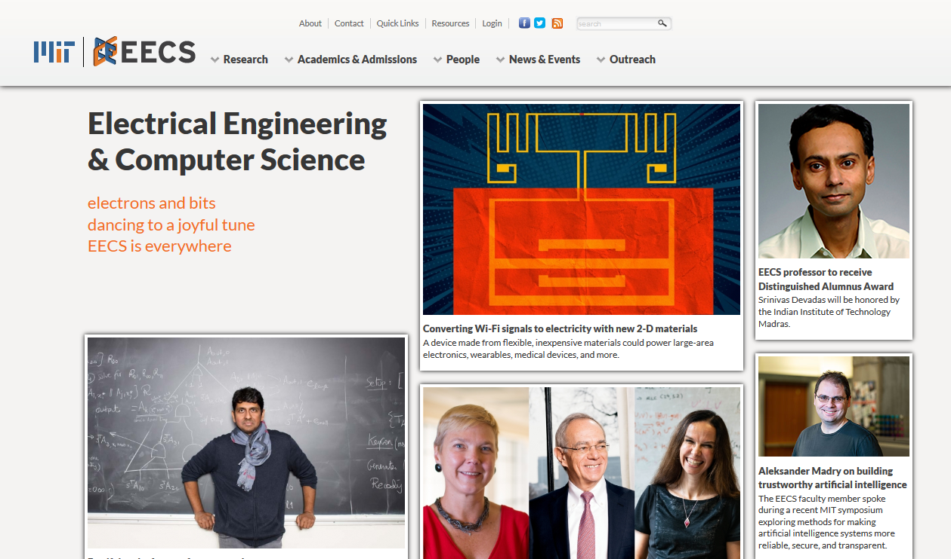
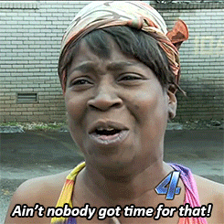
Dislike?
No consistency

Slide 7
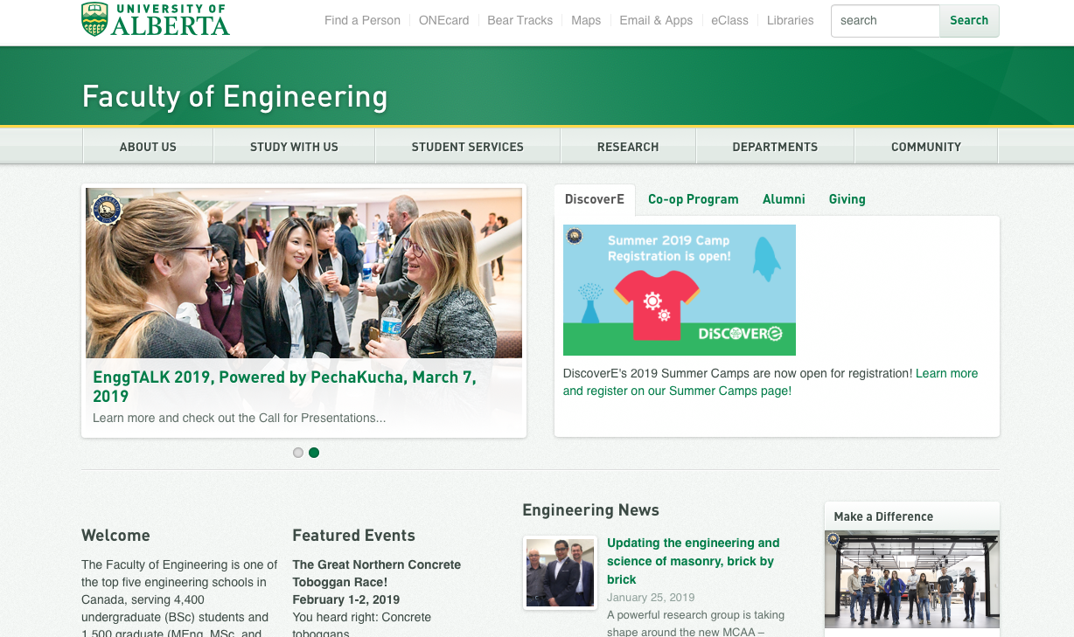
Attractive and simple web page layout design
Very good content strategy, Easy to find all necessary information
Organized structure & content webpage

Slide 8
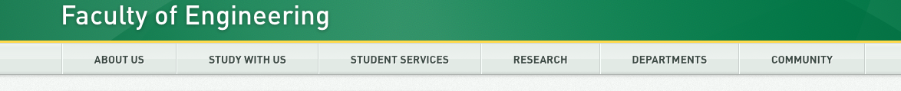
It has very good structure of navigation bar, all necessary information has been organized properly - Current Student can find all necessary information under STUDENT SERVICES
High Usability, High Discoverability , High Desirability !!!
Notes:
Mansi

Slide 9

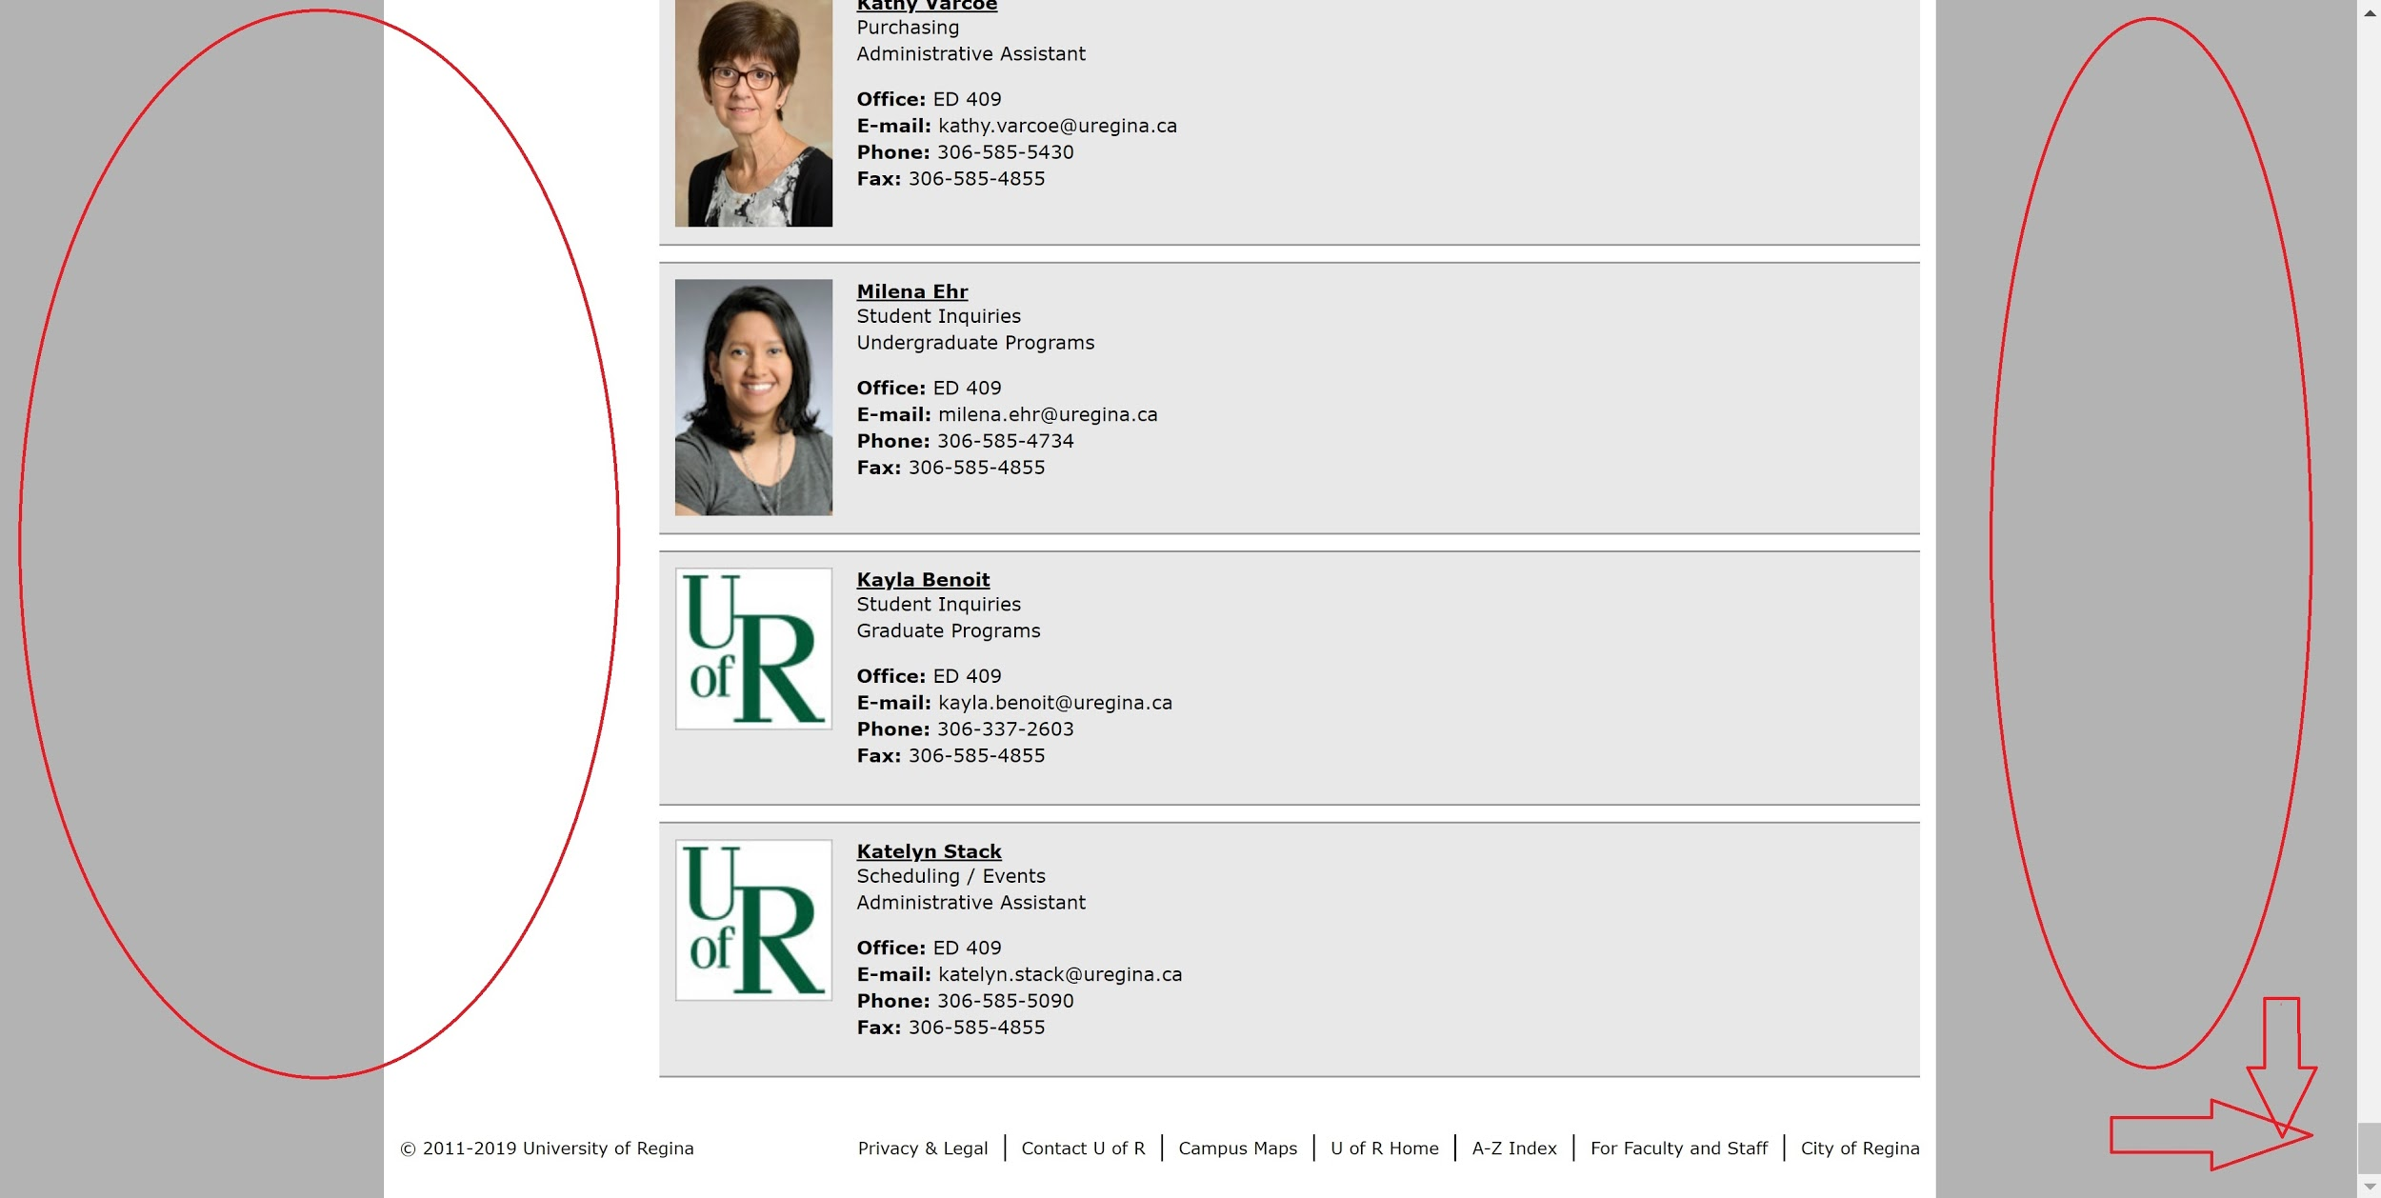
One of the worst website
Simple layout
Harsh user experience
Notes:
Han

Slide 10
Innovative ideas;
Graphical layout
Keep consistent
Organizable
More user-friendly design

Slide 11

Future Students
Future students are the ones applying to the school, they need to:
Know the requirements to enter into the engineering program
Fill out the applications
Find information on the school, and projects they would do in the program they want
Know what’s included in the course syllabus, as well as course descriptions
Be able to search for more information available in the engineering faculty
View projects other students have done in previous years
Know why our engineering faculty is amazing

Slide 12

Current Students
Current students are the ones using the engineering web
page most, they need to:
Know the undergraduate calendar and detailed program sheet
Be able to find necessary forms and able to fill out forms online
Be able to get helpful resources like academic advising, read/write workshop etc.
Can able to see news and events on main webpage of engineering website
Can find other student’s/professor’s project information and research info.
Must able to find contact information of engineering office and faculty member

Slide 13
Graduate Students
Graduate students are the students that have both type of students
which are doing research and normal students like current students, and they have huge task need to be done, don`t have too much time:
Be able to acknowledge the course content
More efficiency work while searching resources
Can find professor who they want to work with in specific area that they want to do their researching
Be able to apply for researching requirements
Be able to communicate with company for Coop work

Slide 14
Research
Future researchers, outside industries might be interested
in the research that associated with Engineering Faculty, so they need to;
Be able to find specific research that matches with self-interest
Manage to find contact information of engineering office and faculty member
Able to fill out the applications
Find other student’s/professor’s project information and research info.
Able to Collaborate

Slide 15
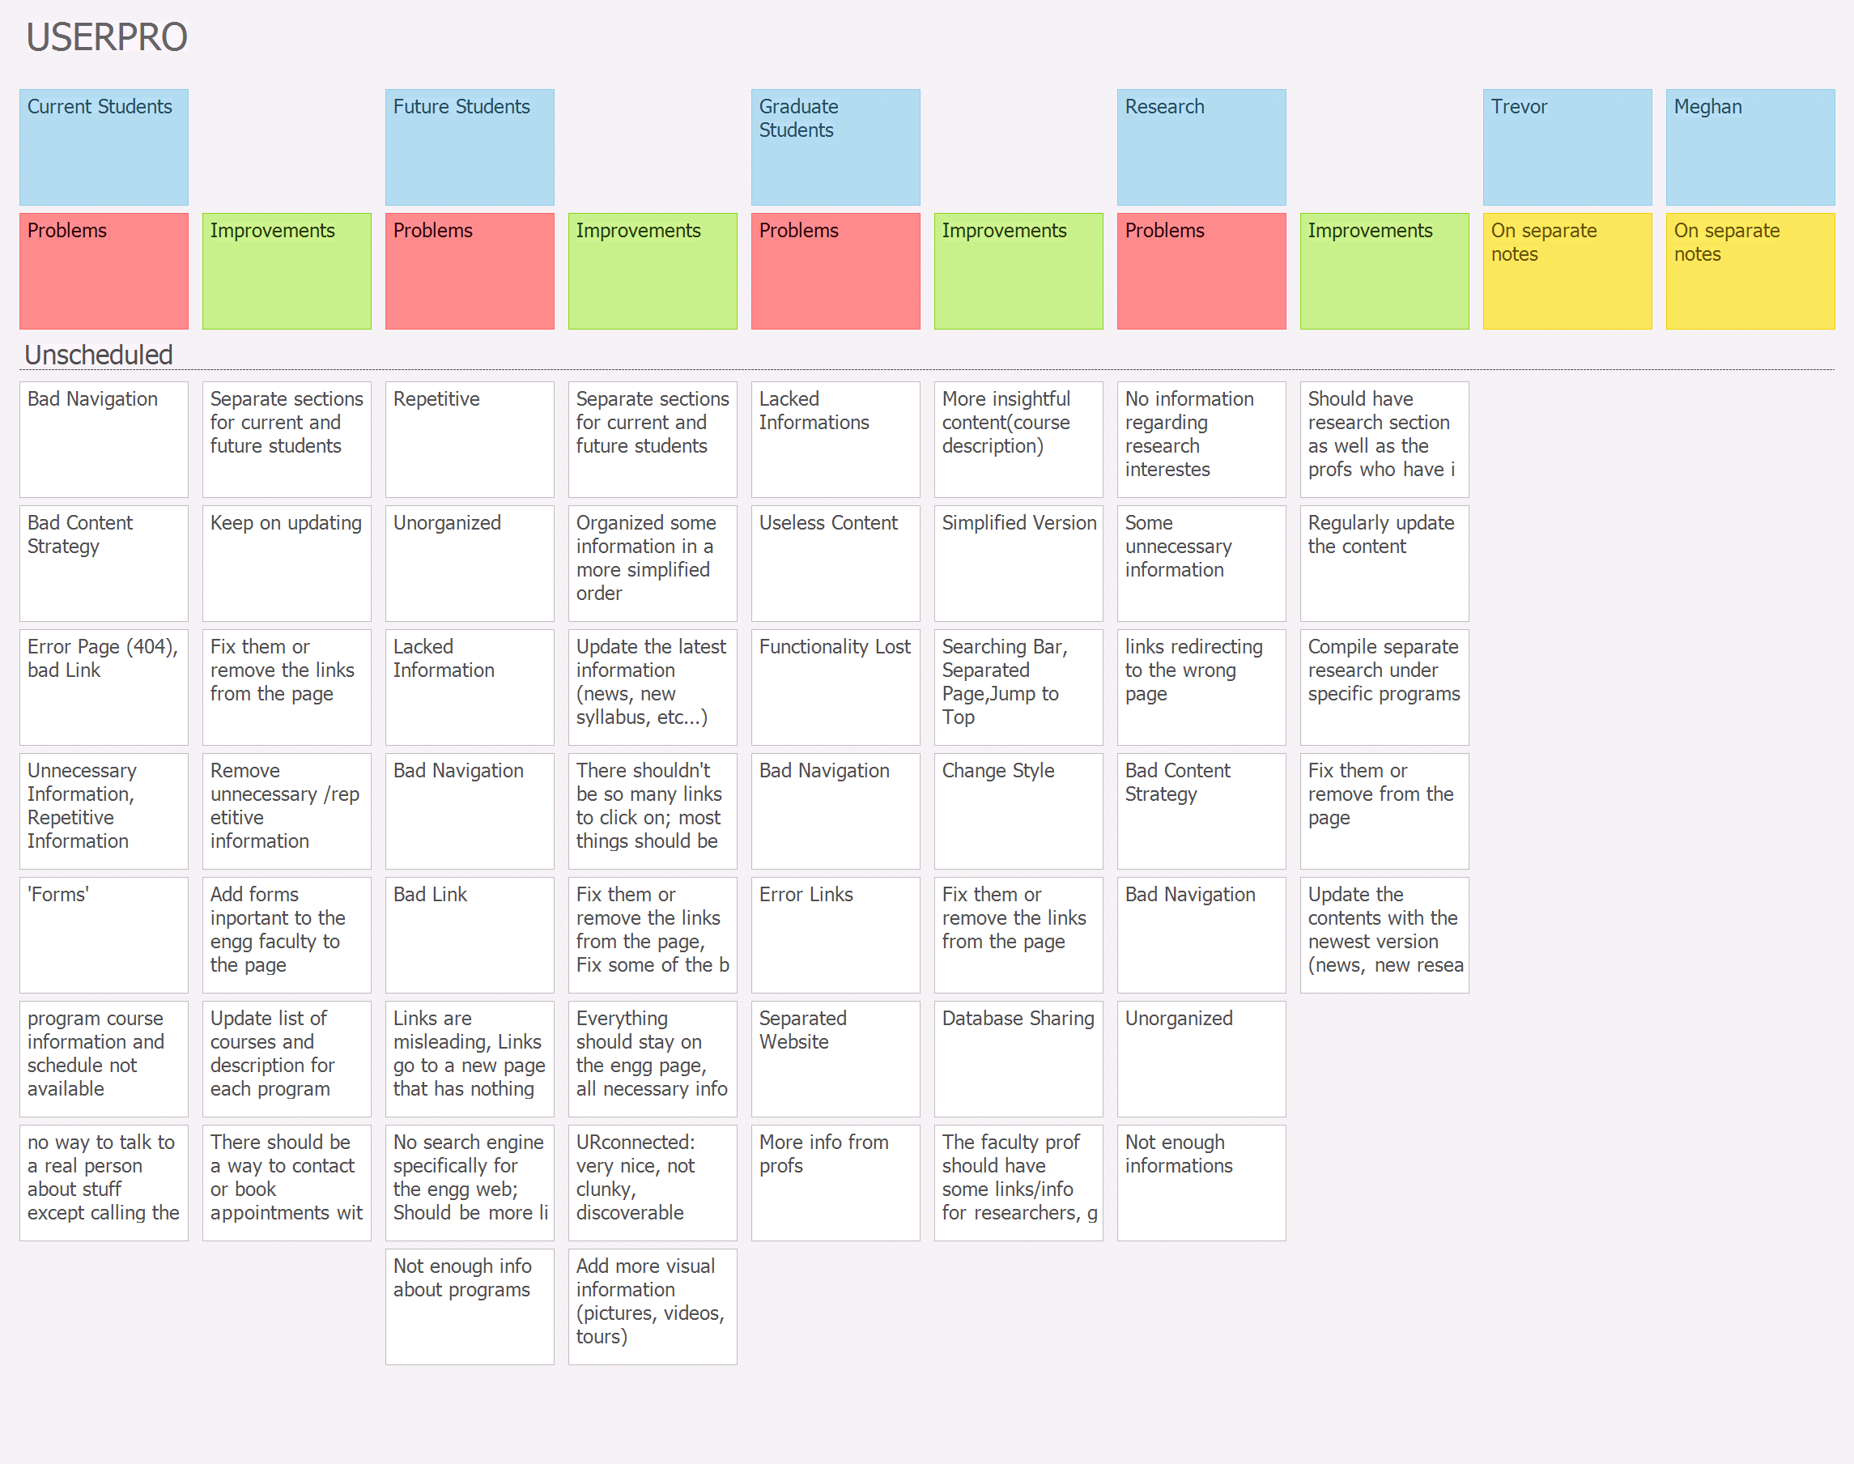

Slide 16
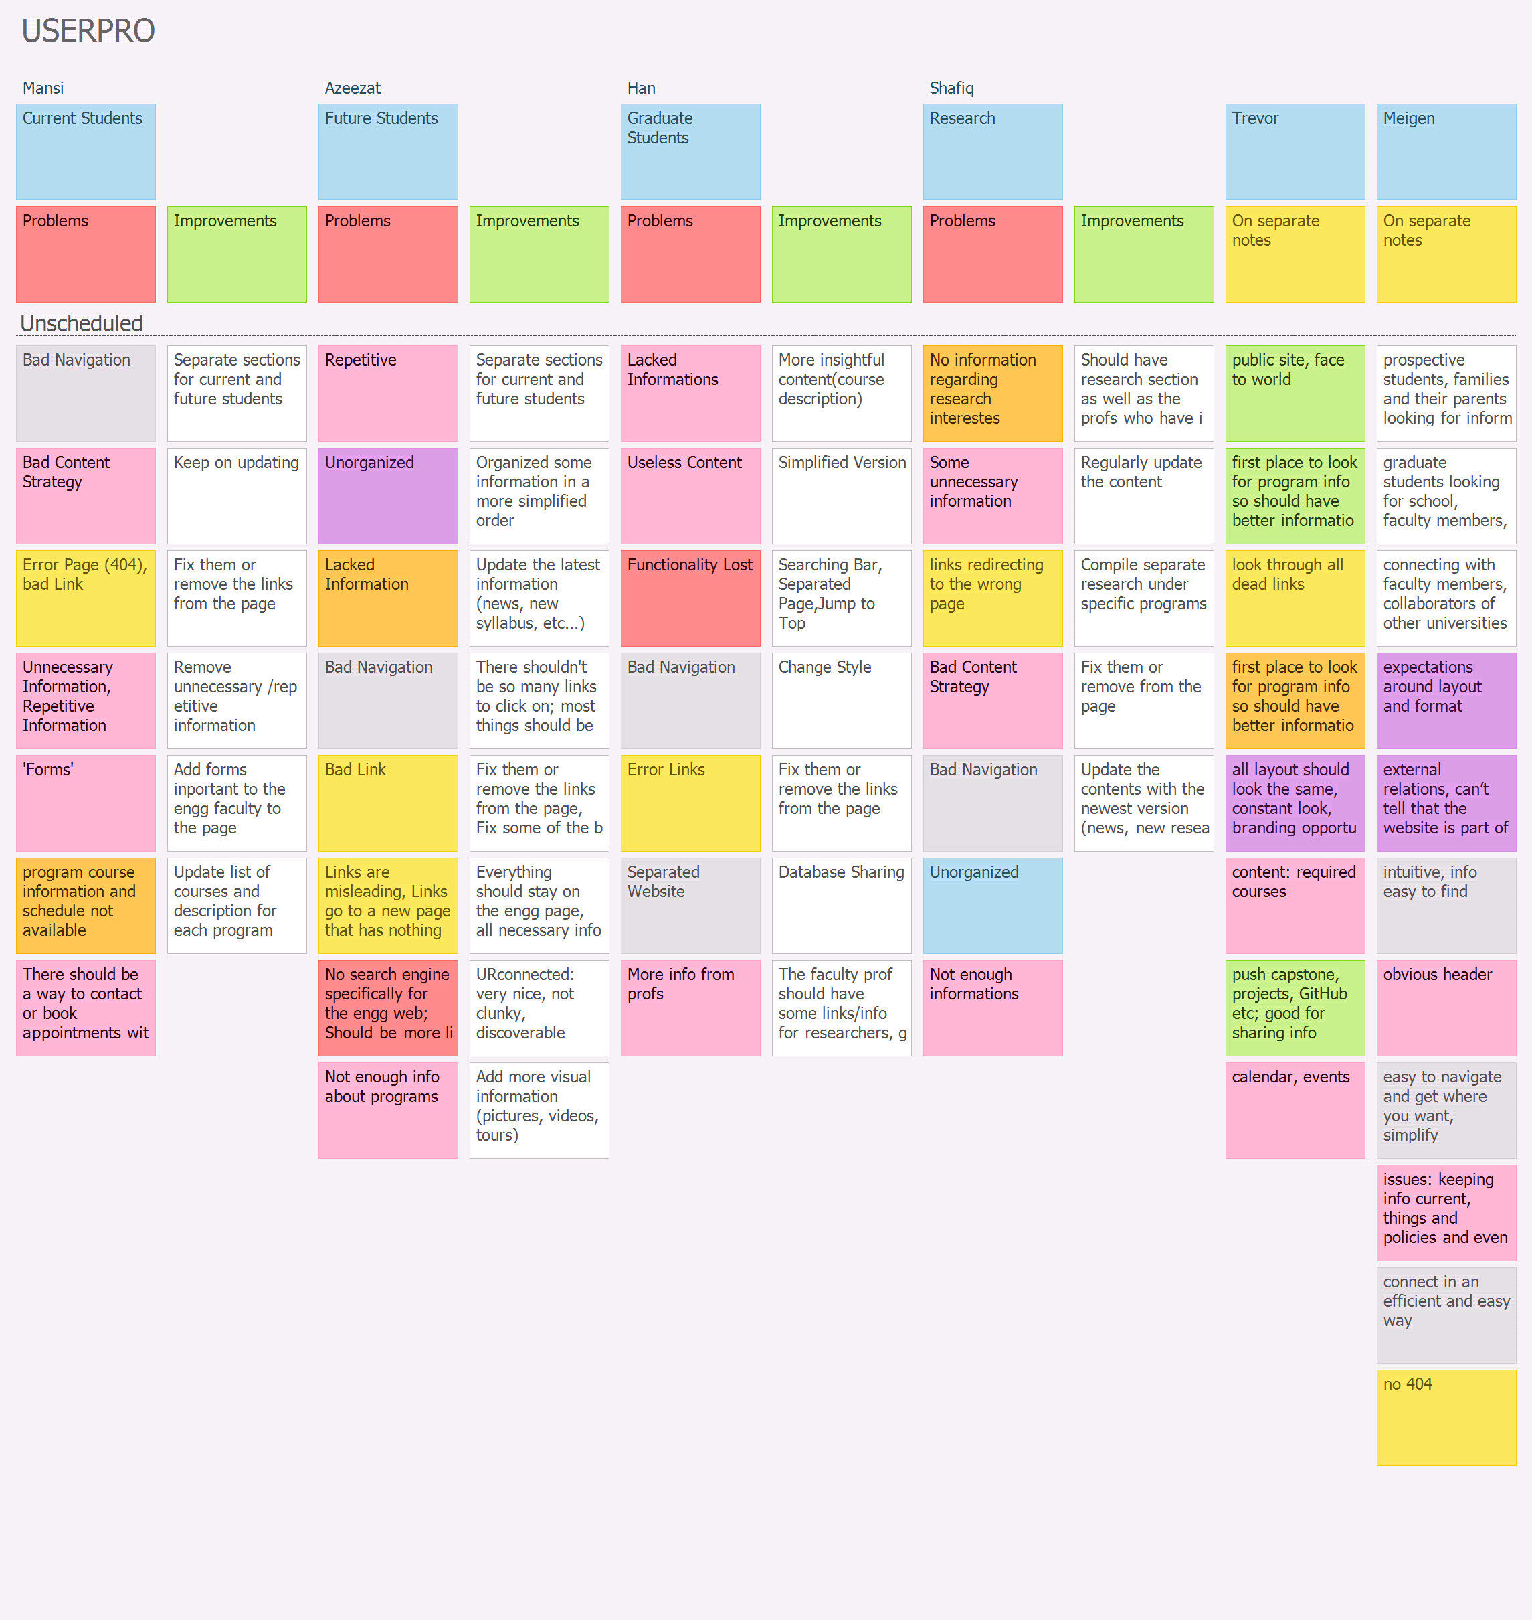

Slide 17
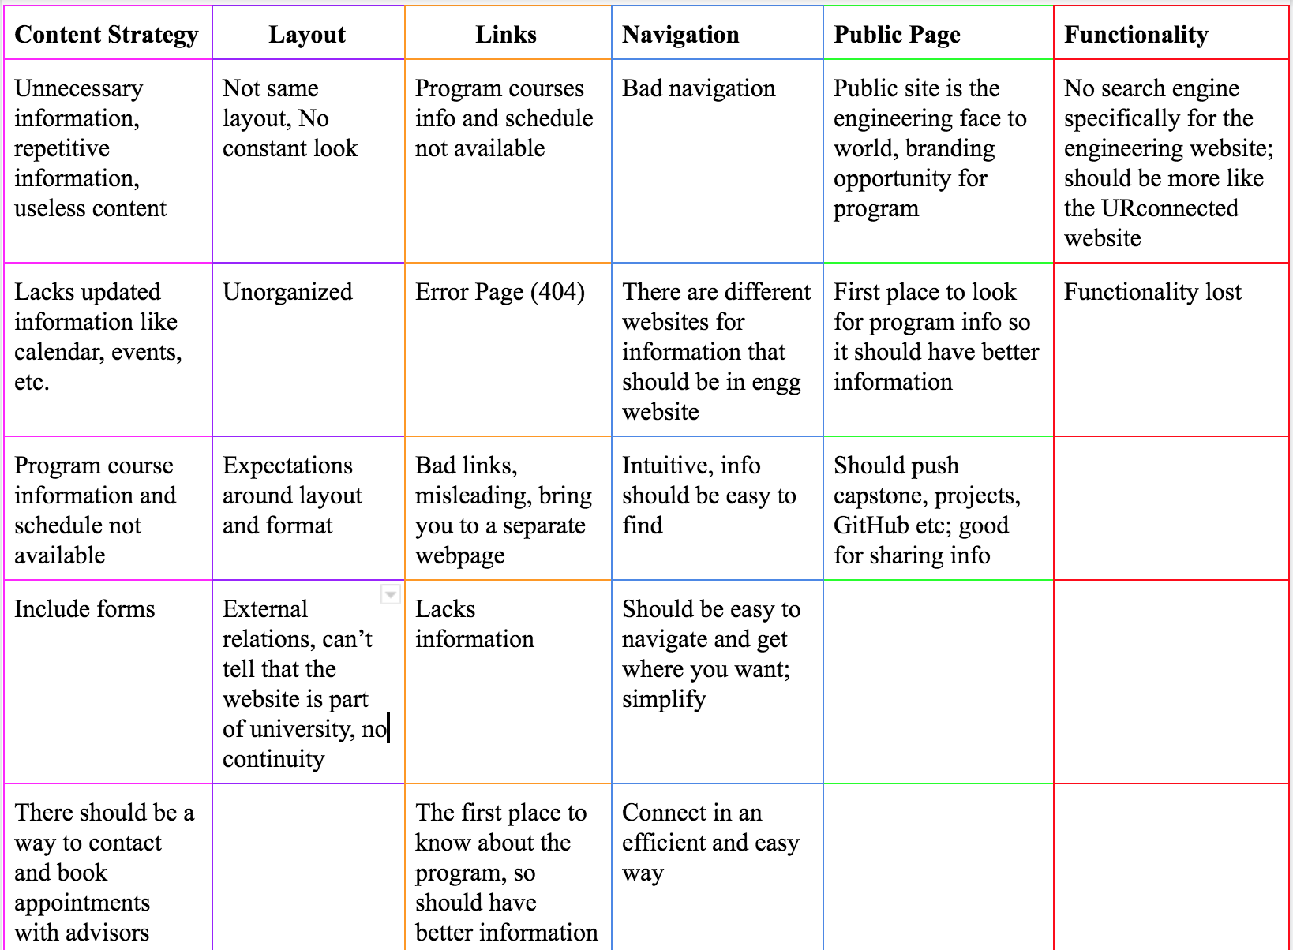
Affinity
Diagram

Slide 18
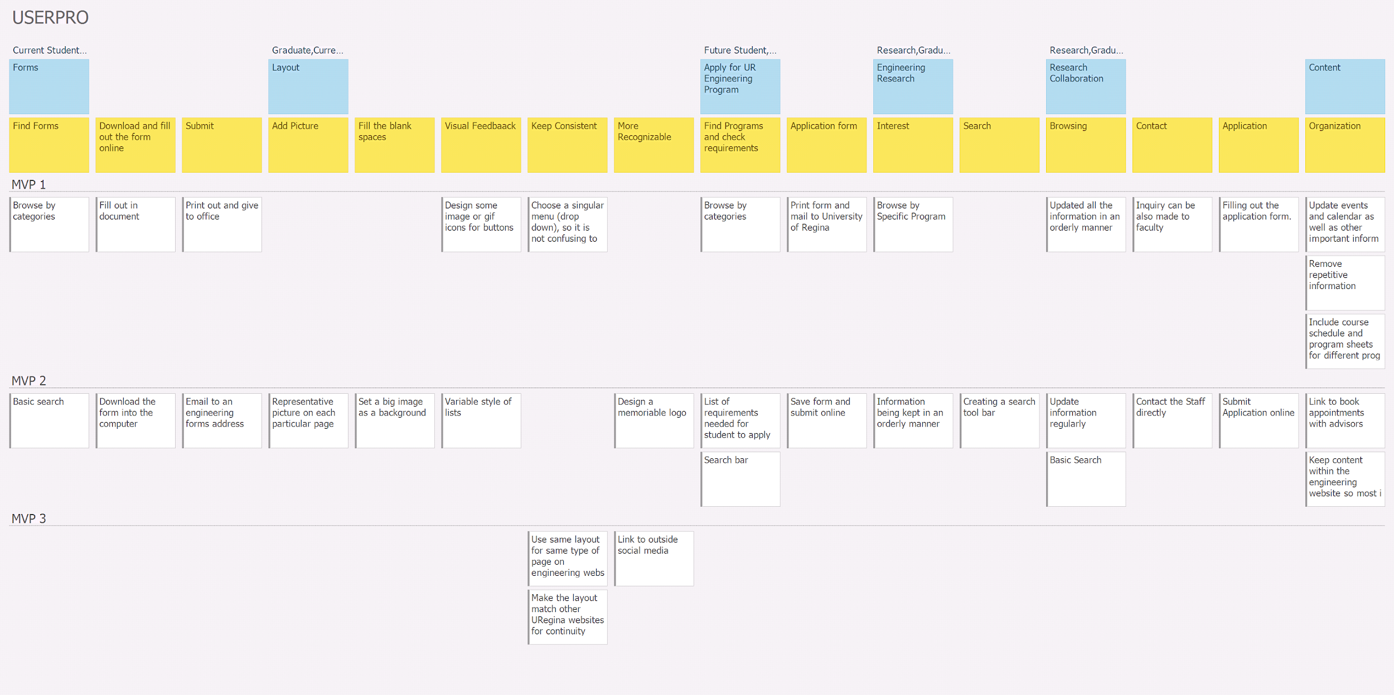

Slide 19
MVP
First MVP is based on getting users to the information they need, and organizing the content for ease of use.
Updated events and calendar - All
Forms - All
Requirements - Future Students & Graduate
Discoverable

Slide 20
GitHub
https://github.com/zainshafiq/User-Interface-Programming-Human-Centered-Design-

Slide 21
Group Reflection
How we felt about this milestone? What we liked about it? What we disliked?
Good practice for user story mapping and affinity diagrams
We like that we were able to use the lab time to work on the milestone.
What we learned about ourselves as we collaborated and worked through this milestone?
We learned that we all suck at time management
Don’t trust Azeezat with time, but she got better. Don’t let Mansi drive. Tell Han the room number an hour before meeting. Trust Shafiq with the memes.
Notes:
Monday

Slide 22
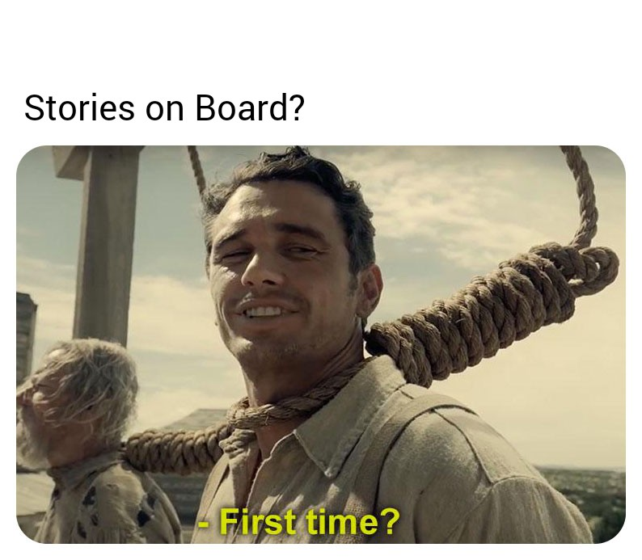
Group Reflection
How we will use what we have learned going forward?
We will force ourselves to do better.
What “stuff & things” related to this milestone we
would want help with?
The user story mapping, scenarios

Slide 23
QUESTIONS?

Slide 24
Group Reflection(Real)
How did you feel about this milestone? What did you like about it? What did you dislike?
What is love?
What did you learn about yourself as you collaborated and worked through this milestone?
Baby don’t hurt me...
How will you use what you have learned going forward?
Don’t hurt me...
What “stuff & things” related to this milestone would you want help with?
No moreeeeee~
Notes:
Monday

